Slide 1
MobileNet

Slide 2
MobileNet
MobileNet is a CNN architecture that is much faster as well as a smaller model that makes use of a new kind of convolutional layer, known as Depthwise Separable convolution. Because of the small size of the model, these models are considered very useful to be implemented on mobile and embedded devices. Hence the name MobileNet.

Slide 3
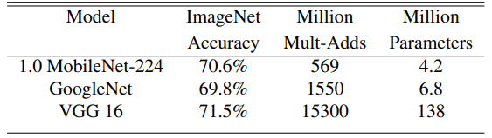
MobileNet parameter and accuracy comparison against GoogleNet and VGG 16 (Source: Table from the original paper)
Table 1 clearly shows how even the deepest MobileNet architectures have fewer parameters than the famous CNN architectures. The smaller MobileNets have as few as 1.3 million parameters. Also, the size of the models is significantly less. While a VGG16 model can take up to 500 MB of disk space, MobileNet just needs 16–18MB. This makes it ideal to be loaded on mobile devices.

Slide 4
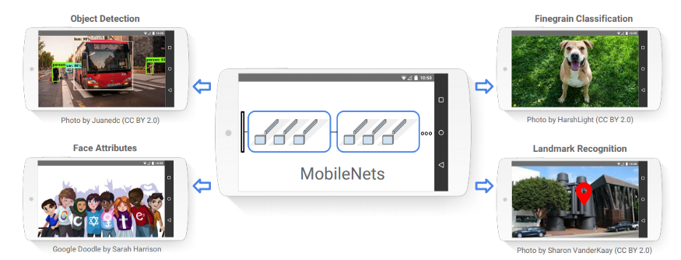
MobileNets can be used for Object Detection, Classification, Attribute detection, or even Landmark recognition on mobile devices (Source: Image from the original paper)

Slide 5
Depthwise Convolutions:
Differences —
The main difference between 2D convolutions and Depthwise Convolution is that 2D convolutions are performed over all/multiple input channels, whereas in Depthwise convolution, each channel is kept separate.
Approach —
Input tensor of 3 dimensions is split into separate channels
For each channel, the input is convolved with a filter (2D)
The output of each channel is then stacked together to get the output on the entire 3D tensor

Slide 6
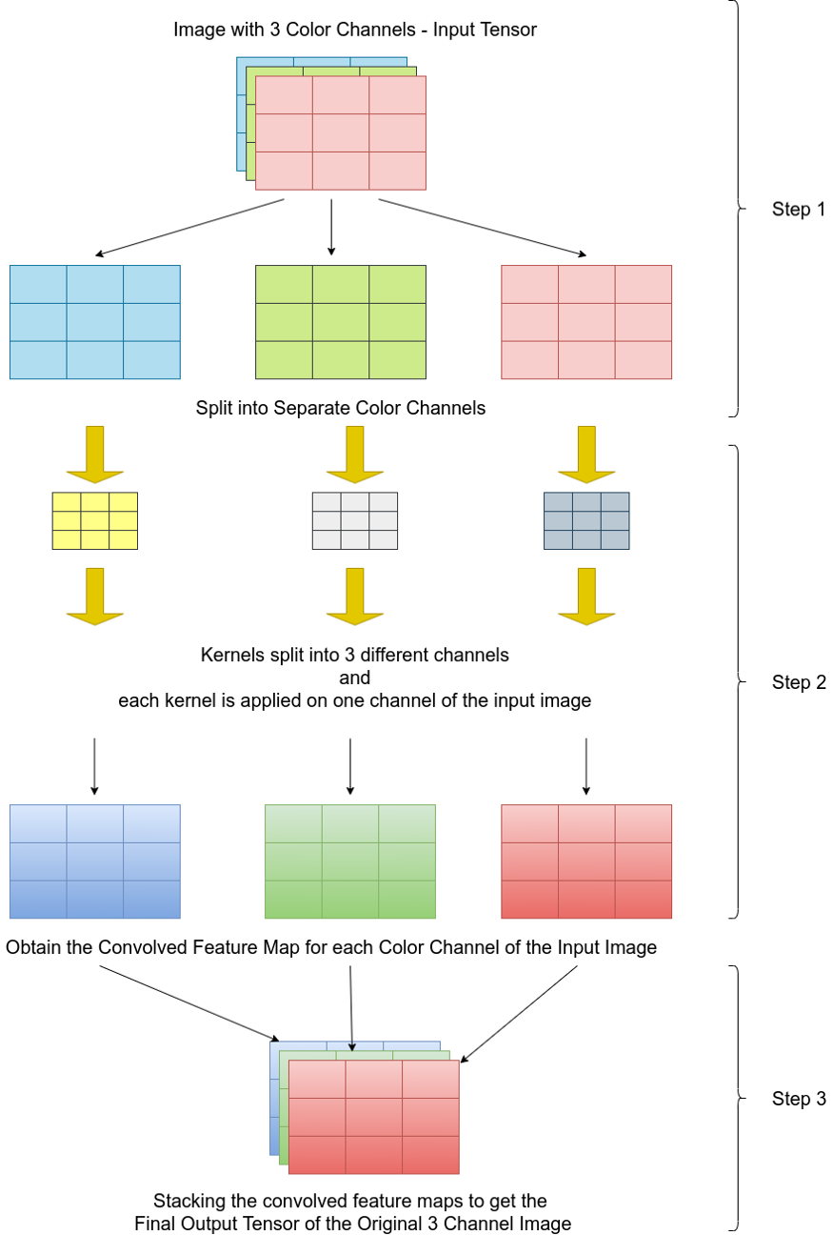
Graphical Description —

Slide 7
Depthwise Separable Convolutions:
Depthwise convolutions are generally applied in combination with another step — Depthwise Separable Convolution. This contains two parts— 1. Filtering (all the previous steps) and 2. Combining (combining the 3 color channels to form ’n’ number of channels, as desired — in the example below we see how the 3 channel can be combined to form a 1 channel output).

Slide 8
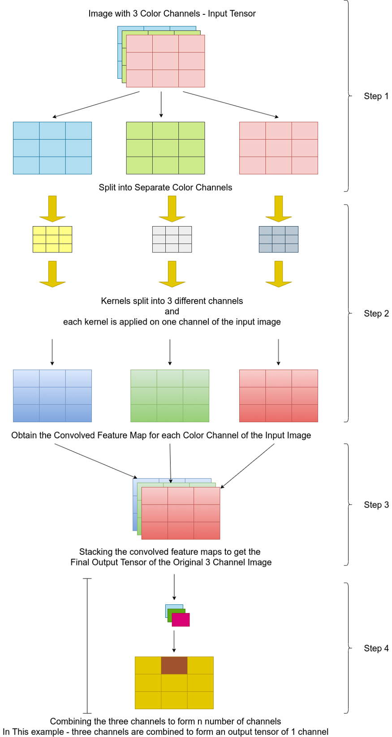

Slide 9
What is MobileNet?
As the name applied, the MobileNet model is designed to be used in mobile applications, and it is TensorFlow’s first mobile computer vision model.
MobileNet uses depthwise separable convolutions. It significantly reduces the number of parameters when compared to the network with regular convolutions with the same depth in the nets. This results in lightweight deep neural networks.
A depthwise separable convolution is made from two operations.
Depthwise convolution.
Pointwise convolution.

Slide 10
1.1 Depth-wise convolution
The depth-wise convolutions are used to apply a single filter into each input channel. This is different from a standard convolution in which the filters are applied to all of the input channels.

Slide 11

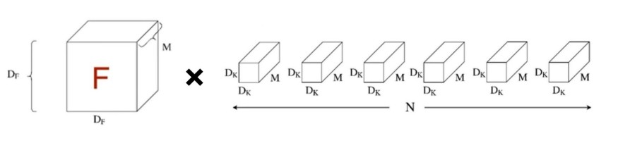
From the image, the computational cost can be calculated as :
Standard Convolution Cost
Where DF is the special dimensions of the input feature map and DK is the size of the convolution kernel. Here M and N are the number of input and output channels respectively.
For a standard convolution, the computational cost depends multiplicatively on the number of input and output channels and on the spatial dimensions of the input feature map and convolution kernel.
standard convolution,

Slide 12
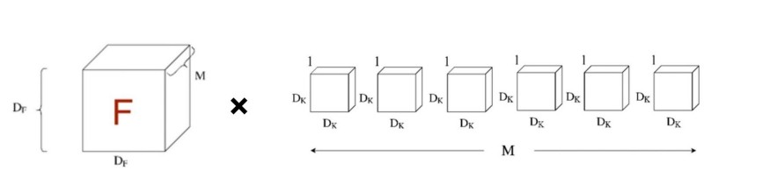

Depth-Wise Convolution cost
Incase of depthwise convolution, as seen in the below image, contains an input feature map of dimension DF*DF and M number of kernels of channel size 1.
As per the above image, we can clearly see that the total computational cost can be calculated as:
However, this method is only used to filter the input channel.

Slide 13
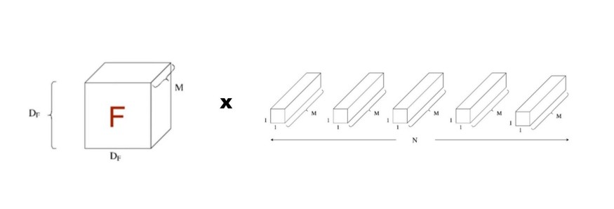

1.2 Point-wise Convolution
Since the depthwise convolution is only used to filter the input channel, it does not combine them to produce new features. So an additional layer called pointwise convolution layer is made, which computes a linear combination of the output of depthwise convolution using a 1 × 1 convolution.
As per the image, let's calculate the computational cost
So the total computational cost of Depthwise separable convolutions can be calculated as:

Slide 14
Parameters of MobileNet
Although the base MobileNet architecture is already small and computationally not very intensive, it has two different global hyperparameters to effectively reduce the computational cost further. One is the width multiplayer and another is the resolution wise multiplayer.

Slide 15

Parameters of MobileNet
3.1 Width Multiplier: Thinner Models
For further reduction of computational cost, they introduced a simple parameter called Width Multiplier also refer as α.
For each layer, the width multiplier α will be multiplied with the input and the output channels(N and M) in order to narrow a network.
So the computational cost with width multiplier would become.
Here α will vary from 0 to 1, with typical values of [1, 0.75, 0.5 and 0.25]. When α = 1, called as baseline MobileNet and α < 1, called as reduced MobileNet. Width Multiplier has the effect of reducing computational cost by α².
3.2 Resolution Multiplier: Reduced Representation
The second parameter to reduce the computational cost effectively. Also known as ρ.
For a given layer, the resolution multiplier ρ will be multiplied with the input feature map. Now we can express the computational cost by applying width multiplier and resolution multiplier as:

Slide 16
MobileNet
Using Depthwise Separable Convolutions
Using two Shrinking Hyperparameters:

Slide 17
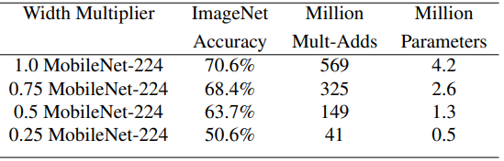
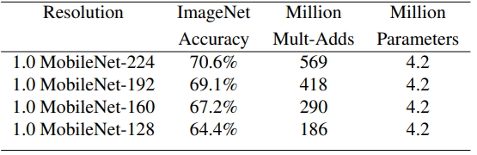
Width multiplier which adjusts the number of channels
b. Resolution multiplier which adjusts the spatial dimensions of the feature maps and the input image
a. Width multiplier which adjusts the number of channels

Slide 18
Why is Depthwise Separable Convolution so efficient?
Depthwise Convolution is -1x1 convolutions across all channels
Let's assume that we have an input tensor of size — 8x8x3,
And the desired output tensor is of size — 8x8x256
Depthwise Convolution is -1x1 convolutions across all channels
Let's assume that we have an input tensor of size — 8x8x3,
And the desired output tensor is of size — 8x8x256

Slide 19
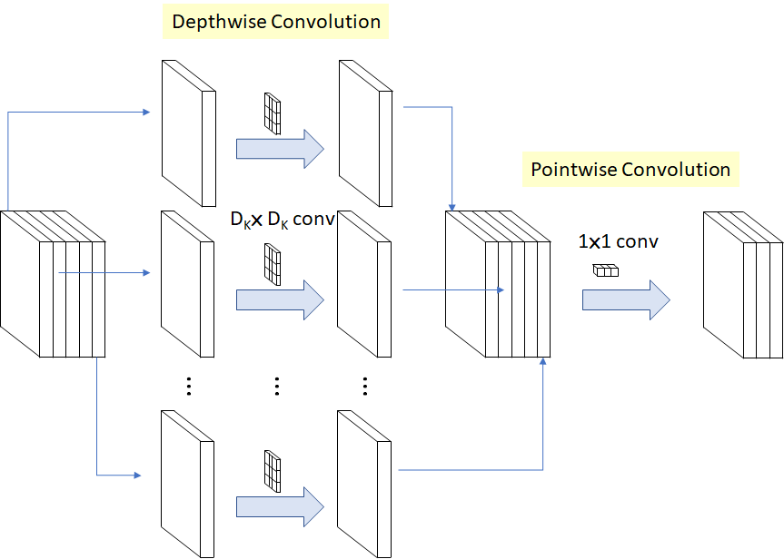
Depthwise separable convolution is a depthwise convolution followed by a pointwise convolution as follows:
Depthwise convolution is the channel-wise DK×DK spatial convolution. Suppose in the figure above, and we have five channels; then, we will have 5 DK×DK spatial convolutions.
Pointwise convolution is the 1×1 convolution to change the dimension.

Slide 20
In Depthwise Separable Convolutions —
The number of multiplications required:
a. Filtering — Split into single channels, so 5x5x1 filter is required in place of 5x5x3, and since there are three channels, so the total number of 5x5x1 filters required is 3, so,
(8x8) x (5x5x1) x (3) = 3,800
b. Combining — Total number of channels required is 256, so,
(8x8) x (1x1x3) x (256) = 49,152
Total number of multiplications = 3,800+49,152 = 53,952
So a 2D convolution will require 1,228,800 multiplications, while a Depthwise Separable convolution will require only 53,952 multiplications to reach the same output.
Finally,
1,228,800/53,952 = 23x less multiplications required

Slide 21
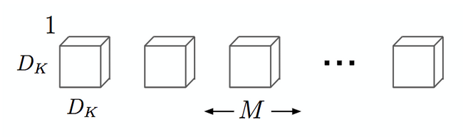
Depthwise convolution.
It is a map of a single convolution on each input channel separately. Therefore its number of output channels is the same as the number of the input channels. Its computational cost is
Df² * M * Dk².

Slide 22
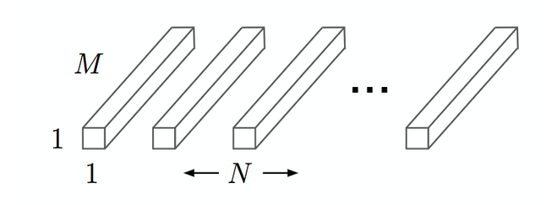
2. pointwise convolution.
Convolution with a kernel size of 1x1 that simply combines the features created by the depthwise convolution. Its computational cost is
M * N * Df².

Slide 23
Hence the efficiency of Depthwise Separable convolutions is so high. These are the layers implemented in the MobileNet architecture, to decrease the number of computations and making them less power-hungry, so that they can be run on mobile / embedded devices which do not have powerful graphical processing units in them.

Slide 24
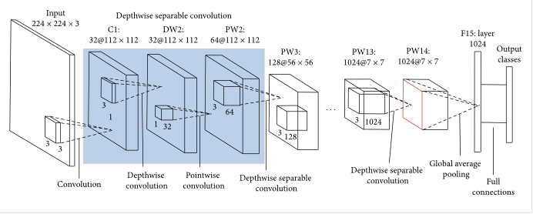
Image Classification With MobileNet

Slide 25
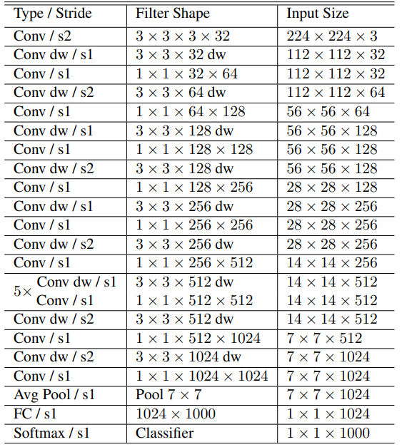
Architecture —
The first layer of the MobileNet is a full convolution, while all following layers are Depthwise Separable Convolutional layers. All the layers are followed by batch normalization and ReLU activations. The final classification layer has a softmax activation. The full architecture is shown in Table 4.

Slide 26
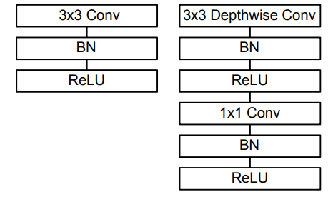
Figure shows the difference in architecture flow between normal CNN models vs MobileNets.
On the left of the image, we see a 3x3 Convolutional layer followed by batch normalization and ReLU, while on the right, we see the Depthwise Separable Convolutional layer — consisting of a 3x3
Depthwise Convolution with a batch norm and ReLU followed by a 1x1 pointwise convolution followed by a batch norm and ReLU.
Left: Standard Convolutional layer, Right: Depthwise Separable Convolutional layers in MobileNet

Slide 27
MobileNets
MobileNets are very efficient and small deep learning architectures specially designed for mobile devices.
Due to the small size, there is a tradeoff of accuracy when compared with the larger fully convolutional architectures, but that is very minute.
For example, on the Stanford dogs dataset, while the Inception V3 model gets an accuracy of 84%, the largest MobileNet gets an accuracy of 83.3%.
But if we look at the number of parameters of each model architecture, while the Inception V3 has 23.2 million parameters, the MobileNet has only 3.3 million parameters.
Also, it is possible to make even smaller and faster MobileNet versions just by using a width multiplier or a resolution multiplier.
This makes MobileNets a highly sought-after deep learning model on mobile and embedded devices.

Slide 28
24,30,18,36,50,64,71,32,105,13,48,44,53,2,54,49,73,14,17,6,55,8,3,73
11,08,18,5,24,04,

